Slide 1
Analyzing marketing campaign – a data-led approach
By – Amit Kumar Mishra

Slide 2
Table of contents
Objectives
Channel Performance Analysis
Retention Metrics
Language and Conversion Analysis
Daily Performance Trends
Demographic Analysis
Strategic Recommendations
Next Steps
Data Sources and Links

Slide 3
Objectives
This analysis aims to provide a comprehensive understanding of our marketing campaign performance and guide strategic decision-making. Our primary objectives are:
Performance Assessment
We seek to evaluate the effectiveness of our current marketing channels by analyzing subscription rates, retention metrics, and conversion patterns across different demographics and languages.
Customer Understanding
Through detailed analysis of age group distributions and language preferences, we aim to develop deeper insights into our customer base. This understanding will enable us to create more targeted and effective marketing strategies that resonate with specific audience segments.

Slide 4
Strategic Direction
Based on our findings, we will determine the most promising opportunities for market expansion and channel optimization. This includes identifying high-potential language markets, optimal timing for campaigns, and the most effective channels for different age groups.
Resource Optimization
By analyzing the relationship between subscription channels and retention rates, we aim to optimize our resource allocation across marketing channels to maximize both user acquisition and long-term engagement.

Slide 5
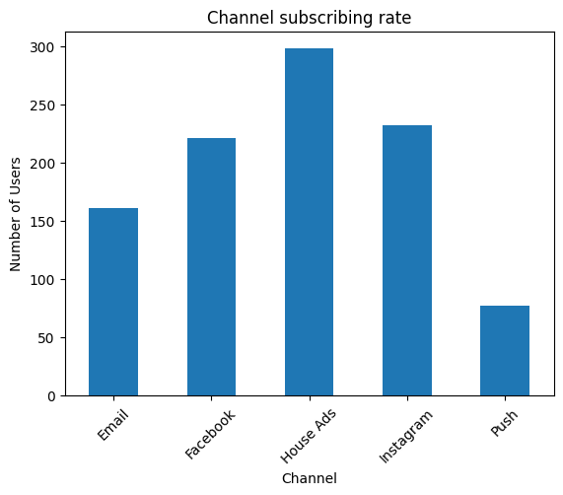
Channel Performance Analysis
House Ads emerge as our strongest subscription channel with approximately 300 subscribers, followed by Instagram and Facebook at around 230 subscribers each.
Email maintains a steady performance with about 160 subscribers, while Push notifications show lower adoption at about 80 subscribers.

Slide 6
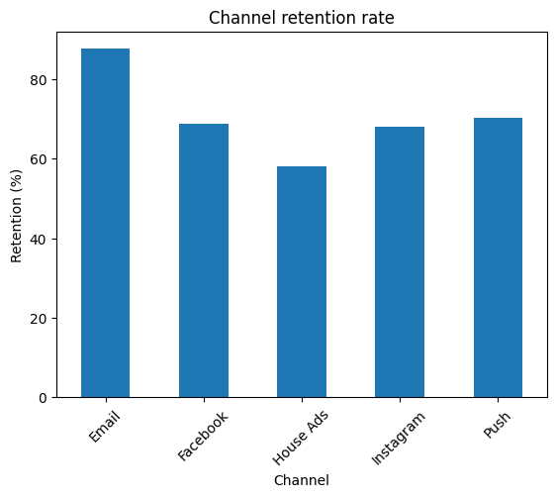
Retention Metrics
Email demonstrates superior retention rates at 85%, significantly outperforming other channels:
Push notifications and Facebook maintain moderate retention at ~70%
Instagram shows consistent performance at ~68%
House Ads, despite high subscription numbers, have the lowest retention at ~58%
This suggests that while House Ads excel at acquisition, they may not attract the most engaged users.

Slide 7
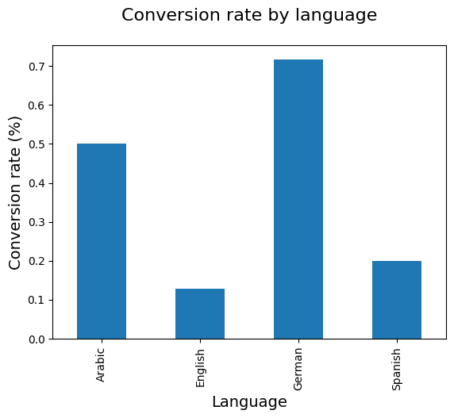
Language & Conversion Analysis
German-speaking audiences show remarkably high conversion rates at 0.7%, followed by:
Arabic: 0.5%
Spanish: 0.2%
English: 0.12%
This indicates a significant opportunity in German-speaking markets and potential for Arabic market expansion.

Slide 8
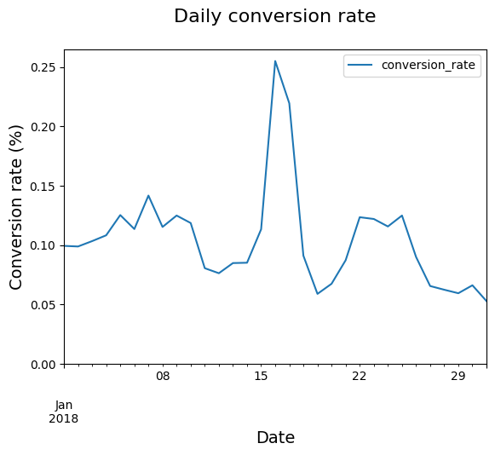
Daily Performance Trends
Conversion Patterns
Peak conversion rate observed mid-month at 0.25%
Regular fluctuations between 0.05% and 0.15%
Notable decline in conversion rates toward month-end

Slide 9
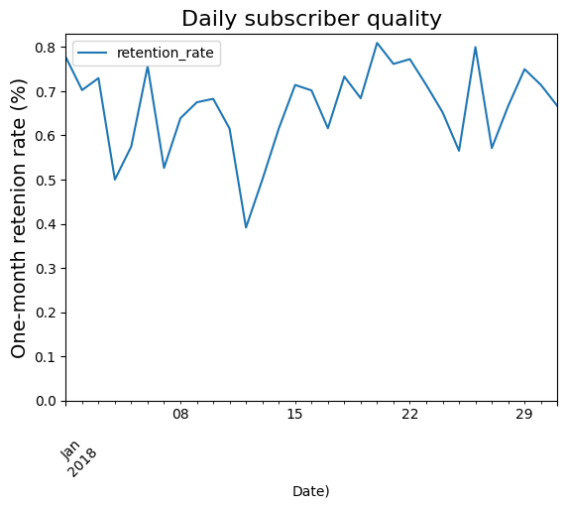
Subscriber Quality
One-month retention rates generally maintain between 60-80%
Periodic dips observed, with lowest point at 40%
Strong recovery patterns post-dips suggest resilient user engagement

Slide 10
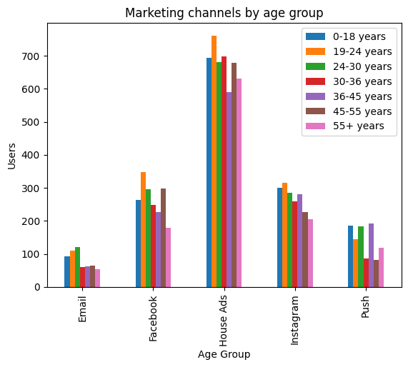
Demographic Analysis
Age Group Distribution
House Ads show strong performance across all age groups, with particular success in:
19-24 years: Highest engagement
0-18 years: Strong secondary audience
Consistent performance across 24-45 age brackets

Slide 11
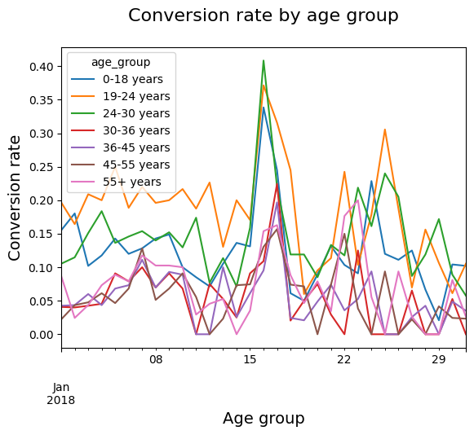
Age-Based Conversion Rates
24-30 years show highest peak conversion at ~0.4%
19-24 years demonstrate most consistent conversion patterns
Older age groups (45+) show lower but more stable conversion rates

Slide 12
Strategic Recommendations
Channel Optimization
Strengthen email marketing given its superior retention rates
Investigate House Ads' retention issues while leveraging their strong acquisition capability
Develop Push notification strategy to improve subscription rates
Market Expansion
Prioritize German-speaking market expansion
Develop targeted campaigns for Arabic-speaking audiences
Review and enhance English market strategy to improve conversion rates
Age-Targeted Campaigns
Focus primary campaigns on 19-30 age bracket
Develop retention strategies for 45+ age groups
Create specialized content for high-converting younger demographics
Timing Optimization
Schedule major campaigns mid-month to capitalize on peak conversion periods
Implement retention initiatives during typical dip periods
Develop strategies to maintain end-of-month performance

Slide 13
Next Steps
Conduct detailed retention analysis for House Ads subscribers
Develop language-specific marketing materials for German and Arabic markets
Create age-specific content strategies for key demographic segments
Implement automated monitoring for conversion rate fluctuations

Slide 14
Data Sources and links
All analyses based on January 2018 data. Regular updates recommended for trend validation.
The code for analysis can be found here:
https://github.com/der-amit/marketinganalytics/blob/main/Analyzing%20marketing%20campaign.ipynb
The data can be found here:
https://github.com/der-amit/marketinganalytics/blob/main/marketingdata.csv

